Slide 1
Course Content
Unit 3 Instructions and Flow of Control
Design criteria for instruction formats
Addressing techniques
Instruction types
Traps & Interrupts

Slide 2
Design criteria for instruction format
Eg. Stack instructions
Opcode
O address instruction
Eg. Load x, increment 1, etc.
Opcode | Address
1 address instruction
Eg. Add 6 to P
Opcode | Address1 | Address2
2 address instruction
Further, three address instructions are also used eg. S=Add 6 to P

Slide 3

Design criteria for instruction format
Length of instruction: shorter are better…!
Memory transfer rate: number of bits per second that can be read out from memory.
Machines word length: It should be an integral multiple of is character code. If the character code size is k, the word length can be k,2k,3k,… otherwise space will be wasted when code is stored.
Number of bits in address fields: longer address means the longer instructions.

Slide 4
Expanding opcode
15 14 13 12 11 10 9 8 7 6 5 4 3 2 1 0
Opcode | Address1 | Address2 | Address 3
A Possible configuration is 15 3-address instructions
0000 | xxxx | yyyy | zzzz
0001 | xxxx | yyyy | zzzz
0010 | xxxx | yyyy | zzzz
….
1110 | xxxx | yyyy | zzzz

Slide 5
Expanding opcode
A Possible configuration is 14 2-address instructions
1111 | 0000 | yyyy | zzzz
1111 | 0001 | yyyy | zzzz
1111 | 0010 | yyyy | zzzz
….
1111 | 1101 | yyyy | zzzz

Slide 6
Expanding opcode
A Possible configuration is 31 1-address instructions
1111 | 1110 | 0000 | zzzz
1111 | 1110 | 0001 | zzzz
….
1111 | 1110 | 1110 | zzzz
1111 | 1110 | 1111 | zzzz
1111 | 1111 | 0000 | zzzz
1111 | 1111 | 0001 | zzzz ….
1111 | 1111 | 1101 | zzzz
1111 | 1111 | 1110 | zzzz

Slide 7
Expanding opcode
A Possible configuration is 31 0-address instructions
1111 | 1111 | 1111 | 0000
1111 | 1111 | 1111 | 0001
….
1111 | 1111 | 1111 | 1111

Slide 8
Addressing techniques
Immediate Addressing:
The instruction itself contains the operand (data) rather than the address of the operand.
This operand is automatically fetched from memory with the instruction.
No extra memory reference is required for the same.
But it restricts an operand to be accommodated in the address length only.
Direct Addressing:
The instruction itself does not contains the operand itself but the address of the ,memory word/cell where it is.
This operand is not automatically fetched from memory with the instruction.

Slide 9
Addressing techniques
Register Addressing:
This is conceptually same as direct addressing except the address field contains the number of register where the operand is stored.
Registers are faster than the memory and they are few so address bits are also less.
Indirect Addressing:
The address specified with the instruction contains again an address of a cell where the actual operand is available.
Note:
Immediate memory addressing requires 0 memory references, as the operand was fetched with the instruction.
Direct requires one and indirect requires 2.

Slide 10
Addressing technique
Instruction: Load R1 from 1000
Opcode | | R1 | 1000
1000
1510
Field Specifying direct addressing
1510
4
Step 1: The operand is fetched from location 1000
Step 2: The operand is loaded into R1
R1
5555

Slide 11
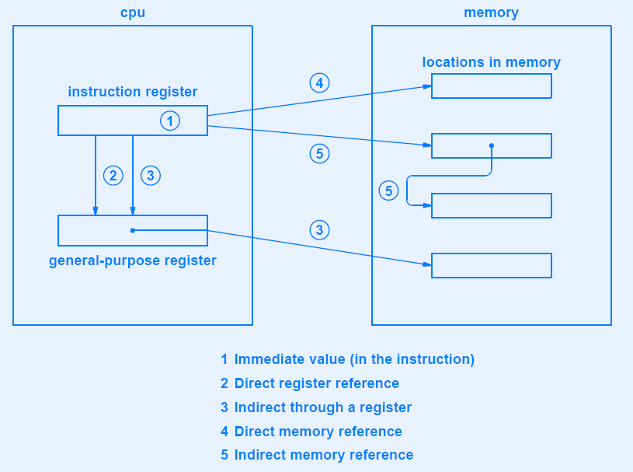

Slide 12
Indexing:
The instruction contains an index register number and a constant.
So, the MOVE A, B will move the contents of memory location A+k to B+k, where k=0 … n.
Incrementing register is faster than incrementing a memory location.
Automatic modification of an index register is known as auto-indexing.
Stack Addressing:
A stack contains instructions with no address.
A stack pointer is used and all the operations –push and pop are restricted to its top only.

Slide 13
Instructions types
Data Movement Instructions:
Data movement instructions are actually data copying instructions.
This requires source, destination and amount of data to be moved.
Common places can be
a memory location
a register or
a stack.

Slide 14
Dyadic Instructions
Dyadic operations are those that requires two operands to produce a result.
AND, OR and XOR operations are the examples for the same.
An important use of AND is to extract bits from the given word using a constant mask.
10110111 10111100 11011011 10001011 (A)
00000000 11111111 00000000 00000000 (B) Mask
-----------------------------------------------------(A AND B)
00000000 10111100 00000000 00000000

Slide 15
Dyadic Instructions
Similarly OR can be used to pack bits into the given word.
10110111 10111100 11011011 00000000 (A)
00000000 00000000 00000000 01010111 (C)
----------------------------------------------------------- (OR)
10110111 10111100 11011011 01010111 (A OR C)

Slide 16
Monadic instructions
Monadic operations have one operand and produce one result.
This has one less address to be specified with it and hence the instruction is shorter.
Negate, Rotate and Shift are the examples of the same.
00000000 00000000 00000000 01110011 (A)
00000000 00000000 00000000 00011100 (A shifted right 2 bits)
00000000 00000000 00000000 01110011 (A)
11000000 00000000 00000000 00011100 (A rotated right 2 bits)

Slide 17
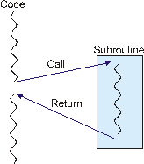
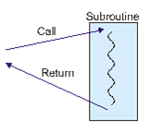
Flow of control
Level 1
Level 2
Level 3
Level 3
Level 2
Level 2
Level 1
Level 1
Level 1
Stack to store return addresses

Slide 18
Traps and interrupts
A Trap is a kind of automatic procedure call initiated by some condition caused by the program.
Trap is also known as exception or fault.
Good example for the same is an overflow, or division by zero.
Mainly software can generate (and hardware detect) such procedure either automatically or user generated.
When trap occurs, flow of control is redirected to a fix memory location, where a trap handler code is available.
Traps are synchronous with the program.

Slide 19
Traps and interrupts
An interrupt is generated by mainly hardware (indirectly by software) as well as by external events such as I/O.; but not by running programs directly.
The address of the code to handle the interrupt must be given to the CPU. That is interrupt handler.
Interrupts are asynchronous with the program.
User generated interrupts are known as trap.

Slide 20
Bus Arbiter
Bus is used by all the components…
When two components need bus at a time, bus arbiter will decide what/who goes next.
Hard disk
Key board
Monitor
Floppy disk drive
CPU
Memory
Keyboard Controller
Video Controller
Hard disk Controller
Floppy disk Controller
Bus

Slide 21
Modem
By varying the amplitude, frequency or phase, sequence of 0 and 1 can be transmitted. This process is known as modulation.
In amplitude modulation, two different voltage levels are used for 0 and for 1.
For more sophisticated system, at the start of each indivisible time interval, the phase of a carrier is shifted by 45,135,225 and 315 degrees to allow two bits per time interval. This is known as digit phase encoding.
On can transmit 3 or more bits per time interval.
The number of time intervals is the baud rate.

Slide 22
Modem
In a frequency modulation, the voltage level is constant but carrier frequency is different for 0 and 1. Such frequency modulation is also called frequency shift keying.
In phase modulation, amplitude and frequency do not change but phase of a career is revered by 180 degrees when the data switches from 0 to 1 and 1 to 0.

Slide 23
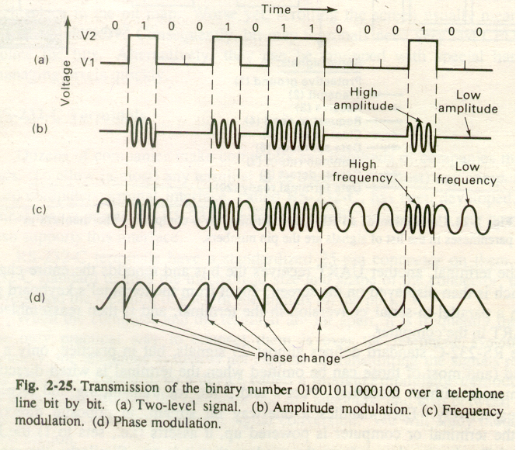

Slide 24
Asynchronous Transmission
The time interval between two characters is not fixed. For example, speed of typing each characters from a standard typewriter is not fixed.
There is no way to distinguish “no data” and 0.
A start bit and one or two stop bits are needed.
Between the start and stop bits data bits are transmitted at uniform speed.
A
S
Y
N
C
Time

Slide 25
Synchronous Transmission
The time interval between two characters is fixed.
Time between characters is constant.
Start bit and two stop bits are not needed.
So, the result is speedy transmission of the data.
S
Y
N
C
Time

Slide 26
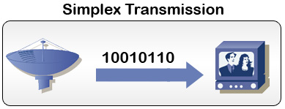

Simplex Transmission
Transmits data in only one direction.
One end is having receiver and another end is having transmitter.
Radio and television broadcasting are examples of the simplex transmission.
learn-networking.com
http://www.knowledgetransfer.net

Slide 27
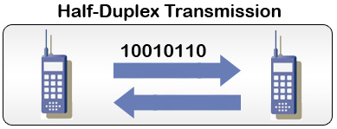

Half Duplex Transmission
Transmits data in both the direction but not simultaneously.
Both the ends modems are available and works as transmitter and receiver, but one at a time.
Telephonic broadcasting and rail roads are examples of the half-duplex transmission.
learn-networking.com
http://www.knowledgetransfer.net

Slide 28
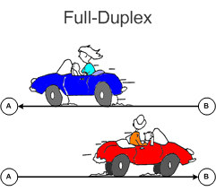
Duplex Transmission
Transmits data in both the direction but simultaneously.
This method will not waste any time for switching directions and can transmits more data.
Conceptually it is equivalent to two simplex lines..
http://www.knowledgetransfer.net

Slide 29
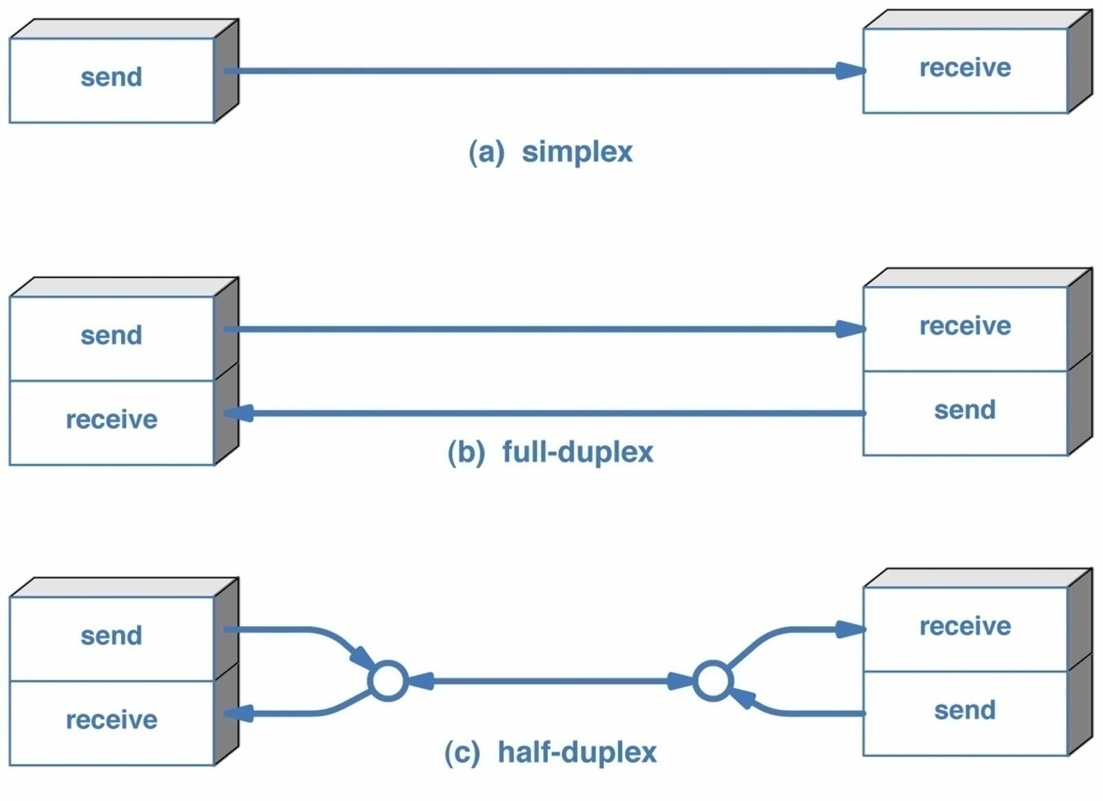
thinklikethinking.blogspot.com

